Slide 1



Information Communication Technology
(CSC101)
Lecture 6
Instructor: Mariam Fiaz
email: mariamsherwani434@gmail.com

Slide 2


Reference Books:
  Understanding Computers: Today and Tomorrow, Comprehensive – Deborah Morley & Charles S. Parker, Cengage Learning, 2017 (Read Chapters 9, 12)
  Computer Science Illuminated – Nell Dale & John Lewis, Jones & Bartlett Learning, LLC, 2020 (Read Chapter 12)

Slide 3
Contents:
Basic Security Concepts
Threats to Users
Threats to Hardware
Threats to Data
Countermeasures
Information Systems
Need for System Development
Enterprise Architecture
Business Intelligence (BI)
Users of Information Systems
Types of Information Systems (TPS, MIS, DSS, EIS)
Responsibility for System Development
System Development Life Cycle (SDLC)
Approaches / Models of System Development

Slide 4
Computer Security:
Definition:
Computer security refers to the protection of computer systems, hardware, software, networks, and data from theft, damage, misuse, or unauthorized access.
Security in information systems focuses on protecting three main components:
• Users
• Hardware
• Data

Slide 5
Computer Security:
Goals of Security:
The main goals of security are:
Confidentiality – information should only be accessed by authorized users.
Integrity – information should remain accurate and not be altered illegally.
Availability – systems and data should be available whenever they are needed.

Slide 6
Threats to Users:
Definition: Threats to users occur when attackers attempt to steal personal information, misuse user accounts, or harm individuals through online activities.
Types of Threats are:
Identity Theft
Loss of Privacy
Online Spying Tools
Online Theft
Online Fraud
Dots Cons (Internet Scams)

Slide 7
Threats to Users:
1. Identity Theft
Identity theft occurs when someone steals another person's personal information and uses it without permission.
Examples:
• Using someone else's credit card
• Opening bank accounts using stolen identity
• Using another person's login credentials
Prevention:
• Strong passwords
• Two‑factor authentication
• Avoid sharing personal information online

Slide 8
Threats to Users:
2. Loss of Privacy
Loss of privacy happens when personal information becomes accessible to others without the user's consent.
Examples:
• Personal photos leaked online
• Personal data collected without permission
• Private messages exposed
Protection:
• Use privacy settings on social media
• Avoid sharing sensitive data online

Slide 9
Threats to Users:
3. Online Spying Tools
Online spying tools are programs that secretly monitor user activities.
Examples:
• Spyware • Keyloggers • Tracking software
These tools can record:
• Passwords • Keystrokes • Browsing history
Protection:
• Install antivirus software
• Avoid downloading unknown applications

Slide 10
Threats to Users:
4. Online Theft
Online theft refers to stealing money or valuable information using the internet.
Examples:
• Hacking bank accounts
• Stealing digital wallets
• Unauthorized financial transactions

Slide 11
Threats to Users:
5. Online Fraud
Online fraud occurs when criminals deceive people through the internet in order to obtain money or confidential information.
Examples:
• Fake online shopping websites
• Lottery scams
• Fake job offers

Slide 12
Threats to Users:
6. Dot Cons (Internet Scams)
Dot cons refer to fraudulent activities conducted on the internet.
Examples:
• Fake investment schemes
• Phishing emails
• Fake charity websites

Slide 13
Threats to Hardware:
Hardware threats refer to risks that can damage or destroy computer equipment.
1. Power Related Threats
Electrical problems can damage computer hardware.
Examples:
• Power failures
• Voltage fluctuations
• Power surges
Protection:
• Use UPS (Uninterruptible Power Supply)
• Use surge protectors

Slide 14
Threats to Hardware:
2. Hardware Loss
Hardware loss occurs when equipment is stolen or misplaced.
Examples:
• Laptop theft
• Lost USB drives
Protection:
• Physical security
• Device tracking systems

Slide 15
Threats to Hardware:
3. Hardware Damage
Hardware damage occurs due to environmental or physical conditions.
Examples:
• Water damage
• Dust
• Overheating
Protection:
• Proper ventilation
• Safe storage

Slide 16
Threats to Hardware:
4. System Failure
System failure occurs when the computer system stops working properly.
Examples:
• Operating system crash
• Hard disk failure
Protection:
• Regular maintenance
• Data backups

Slide 17
Threats to Hardware:
5. Unauthorized Access and Unauthorized Use
Unauthorized access occurs when someone enters a system without permission.
Unauthorized use occurs when a person uses a system in a way that is not allowed by the organization.
Examples:
• Accessing confidential files
• Using someone else's account
Protection:
• Password protection
• Authentication systems

Slide 18
Threats to Hardware:
6. Natural Disasters
Natural disasters can damage computer systems and infrastructure.
Examples:
• Floods
• Earthquakes
• Fires
Protection:
• Disaster recovery planning
• Off‑site data backups

Slide 19
Threats to Data:
Data threats involve the destruction, corruption, or theft of digital information.
1. Malware
Malware means malicious software designed to damage systems or steal data.
Types of malware:
• Virus • Worm • Trojan Horse • Spyware • Ransomware
Effects:
• Data loss
• System slowdown
• Unauthorized access

Slide 20
Threats to Data:
2. Virus and Malicious Programs
A virus is a program that attaches itself to files and spreads between computers.
Effects:
• Corrupt files
• Delete important data
• Damage operating systems
Protection:
• Antivirus software
• Avoid suspicious downloads

Slide 21
Threats to Data:
3. Cybercrime
Cybercrime refers to illegal activities performed using computers or the internet.
Examples:
• Hacking
• Identity theft
• Online fraud

Slide 22
Threats to Data:
4. Cyber‑Terrorism
Cyber‑terrorism involves attacks on computer networks intended to cause fear, interruption , or damage to national infrastructure.
Targets:
• Government systems
• Banking systems
• Power grids

Slide 23
Countermeasures:
Countermeasures are techniques used to protect systems from threats.
Examples:
• Antivirus software
• Firewalls
• Encryption
• Regular backups
• Security policies

Slide 24
Information Systems:
Definition:
An Information System is a collection of people, hardware, software, data, and procedures that work together to collect, process, store, and distribute information.
Components of Information Systems:
• Hardware • Software • Data • Procedures • People
Purpose:
• Support business operations
• Improve decision making
• Increase organizational efficiency

Slide 25
Need for System Development:
Organizations develop information systems to:
• Improve efficiency
• Handle large volumes of data
• Automate business operations
• Improve decision making
System development ensures that systems meet organizational requirements.

Slide 26
Enterprise Architecture:
Enterprise Architecture is the overall design and structure of an organization's information systems and IT infrastructure.
It includes:
• Applications
• Databases
• Networks
• Technology infrastructure
Purpose:
• Align IT systems with business goals

Slide 27
Business Intelligence (BI):
Business Intelligence refers to technologies and processes used to analyze business data and support better decision making.
Examples:
• Data analytics
• Dashboards
• Data warehouses
Benefits:
• Identifies business trends
• Improves strategic planning

Slide 28
Users of Information Systems:
Different people interact with information systems for different purposes.
1. End Users
Employees who use systems to perform daily tasks.
2. Managers
Managers use information systems to monitor performance and make decisions.
3. IT Specialists
IT professionals design, develop, and maintain systems.
Examples:
• System analysts • Programmers • Database administrators

Slide 29
Types of Information Systems:
1. Transaction Processing System (TPS)
TPS processes routine daily business transactions.
Examples:
• ATM transactions
• Point of Sale (POS) systems
• Payroll processing
Characteristics:
• Handles large volumes of data
• Fast processing
• High accuracy

Slide 30
Types of Information Systems:
2. Management Information System (MIS)
MIS converts data from TPS into useful reports for managers.
Examples:
• Monthly sales reports
• Inventory reports
Purpose:
• Support managerial decision making

Slide 31
Types of Information Systems:
3. Decision Support System (DSS)
DSS helps managers analyze complex problems and evaluate different solutions.
Examples:
• Financial planning systems
• Forecasting systems

Slide 32
Types of Information Systems:
4. Executive Information System (EIS)
EIS provides summarized information to top executives for strategic decisions.
Examples:
• Executive dashboards
• Corporate performance monitoring

Slide 33
Responsibility for System
Development:
System development requires teamwork among different professionals.
Key participants:
System Analysts – analyze system requirements.
Programmers – write software code.
Project Managers – manage development projects.
Database Administrators – manage organizational data.
End Users – provide feedback and use the system.

Slide 34
System Development Life Cycle (SDLC):
SDLC is a structured process used to design and develop information systems.
Phases of SDLC
Planning - Identify problems and determine project feasibility.
Analysis - Gather and analyze user requirements.
Design - Create system architecture and database design.
Development - Develop software through coding.
Testing - Test the system to detect and correct errors.
Implementation - Install the system and make it operational.
Maintenance - Update and maintain the system after deployment.

Slide 35
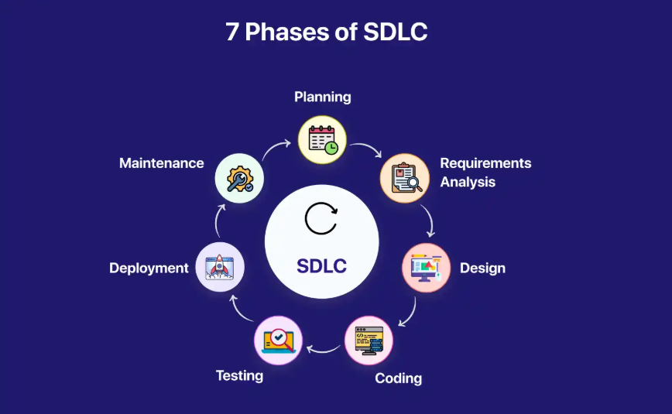

Slide 36
Approaches/Models of System
Development:
Approaches or Models are used for System Development are:
1. Waterfall Model
A sequential model where each phase must be completed before the next begins.
Advantages:
• Simple and structured
Disadvantages:
• Difficult to make changes during development

Slide 37
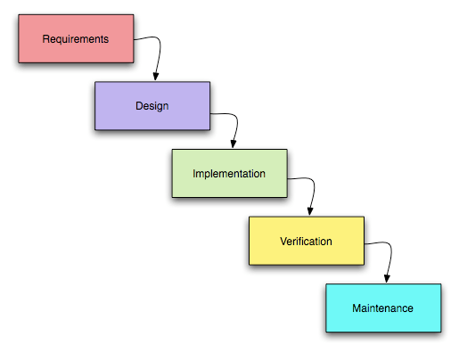

Slide 38
Approaches/Models of System
Development:
2. Agile Model
An iterative development model that focuses on flexibility and user feedback.
Advantages:
• Faster development
• Adaptable to changes

Slide 39
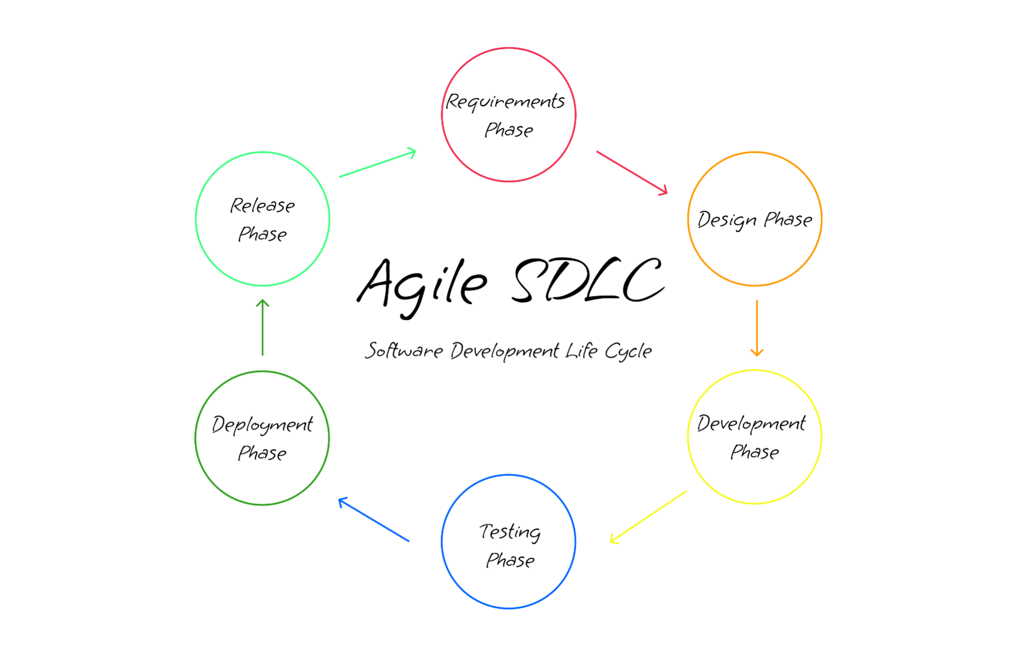

Slide 40
Approaches/Models of System
Development:
3. Prototyping Model
A preliminary version of the system is built to understand user requirements.
Steps:
• Build prototype
• Gather feedback
• Improve design

Slide 41
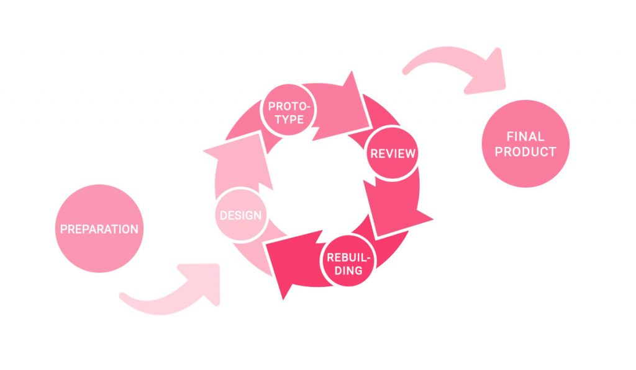

Slide 42
Approaches/Models of System
Development:
4. Rapid Application Development (RAD)
RAD focuses on fast development using reusable components and automated tools.
Advantages:
• Quick system delivery
• High user involvement

Slide 43
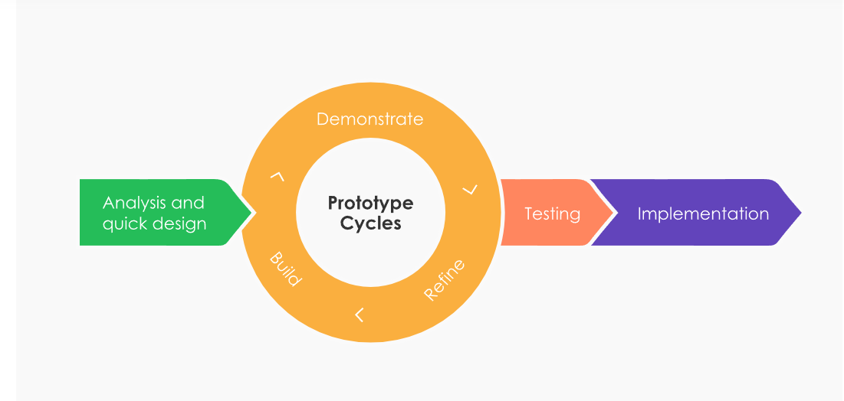

Slide 44
Summary of Lecture
Computer security protects users, hardware, and data from threats such as identity theft, malware, and online fraud. Organizations use information systems to collect, process, and manage information for daily operations and decision making. Different systems like TPS, MIS, DSS, and EIS support different management levels. Systems are developed using the SDLC process and various development models such as Waterfall, Agile, and Prototyping.

